Slide 1

Taxi Fare Prediction
Group – 02
Group Members:-
Hemank Soni (B21293)
Rajeev Kaidan (B21216)
Nishant (B21308)
Keshav Verma (B21299)
Dharkan Anand (B21043)
Aayushi Thakur (B21028)

Slide 2

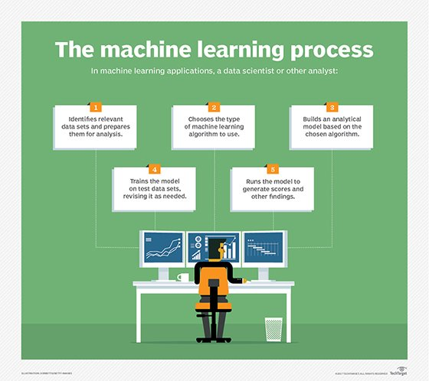
Problem Statement
We are given with the training data set containing the different attributes like pick/drop locations, weather conditions, time etc. on basis of which we have to predict the taxi fares in the areas near New York city.
So, we are going to predict the taxi fare using Machine Learning Model.

Slide 3

Methodology:
Glance
Data Preprocessing
Data Cleansing and Cleaning
Selection of Boundary Box
Extracting Date and Time
Haversine formula
Linear Regression
Accuracy Measure

Slide 4

Data Preprocessing
It is a component of data preparation, describes any type of processing performed on raw data to prepare it for another data processing procedure.
Data preprocessing transforms the data into a format that is more easily and effectively processed in machine learning.
In provided data :
Condition for Positive Fare Including Zero
Missing values are addressed
latitude and longitude should be between 0 to 180 degrees

Slide 5
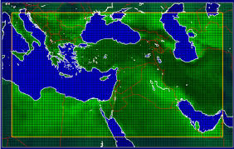
Selection of Boundary Box
The bounding box is an imaginary rectangular box that contains an object or a set of points. Bounding box refers to the border’s coordinates that enclose an image. They are often used to bind or identify a target and serve as a reference point for object detection and create a collision box for that object.
We have created a range with the help of latitudes and longitudes using this Boundary Box .
This range is defined to perform the required algorithms for a specific region.

Slide 6

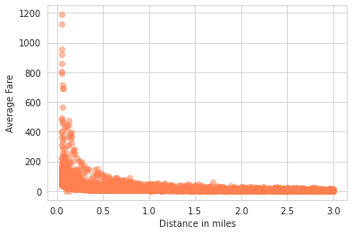
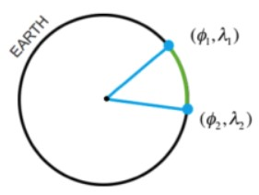
Haversine formula
If you have two different latitude – longitude values of two different point on earth, then with the help of Haversine Formula, you can easily compute the great-circle distance (The shortest distance between two points on the surface of a Sphere).
In our data we have calculated distances to perform various operations with respect to distance and analyse the data for further requirements.

Slide 7
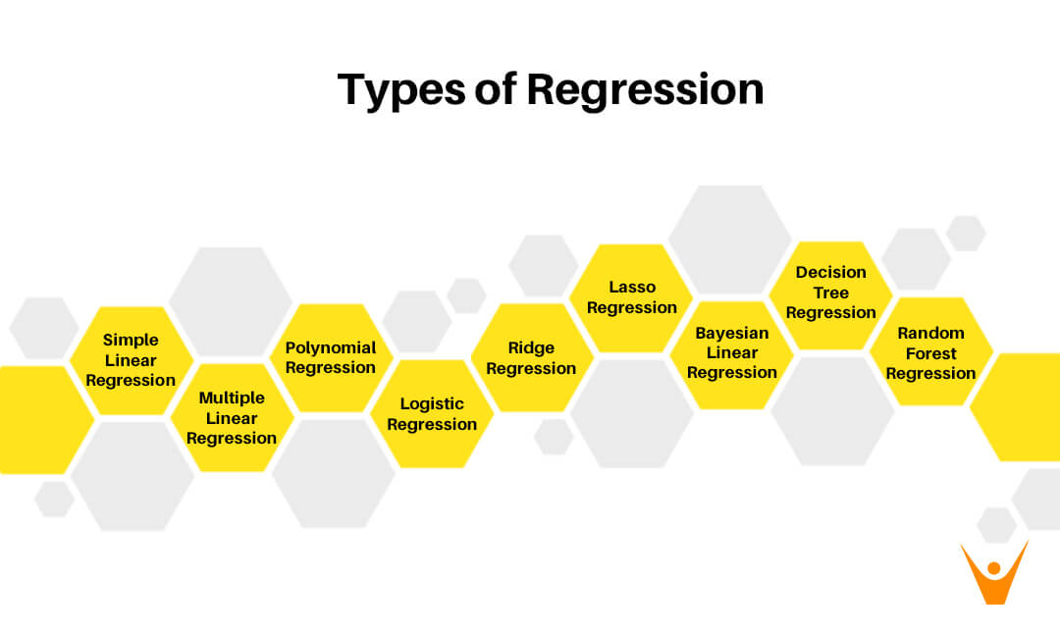
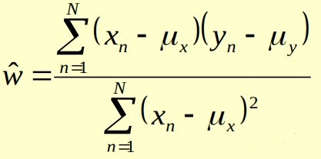


Linear Regression
We use Multiple Linear Regression for the prediction of the taxi fare in the New York City. This is the main methodology we use in this project.
Linear Regression basically is the linear approach to model the relationship between the given independent variable/variables and the dependent variable/variables.
The output is going to be the linear function of the independent variables.
In Multiple linear regression there are more than one independent variable and a single dependent variable which is to be predicted.
y_{n} = w_{d}x_{nd} + …….+ w₂x_{n2} + w₁x_{n1} + w₀ = w^{T}x_{n}

Slide 8
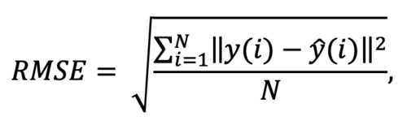
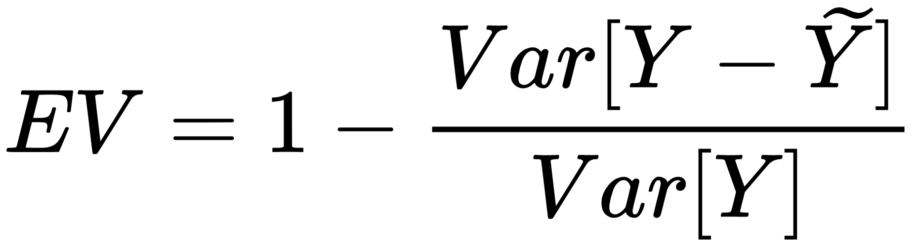
Accuracy Measure
RMSE : Root Mean Squared Error
In machine learning, it is extremely helpful to have a single number to judge a model’s performance, whether it be during training, cross-validation, or monitoring after deployment. Root mean square error is one of the most widely used measures for this.
EVS : Explained Variance Score
The explained variance is used to measure the proportion of the variability of the predictions of a machine learning model. Simply put, it is the difference between the expected value and the predicted value. It is a very important concept to understand how much information we can lose by reconciling the dataset

Slide 9
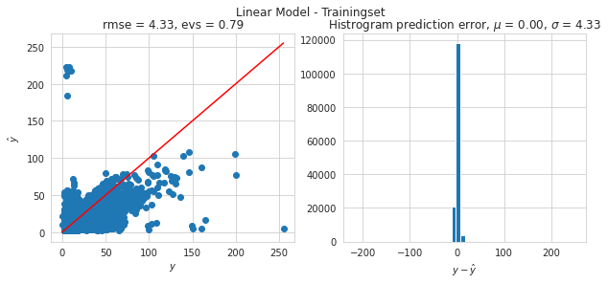
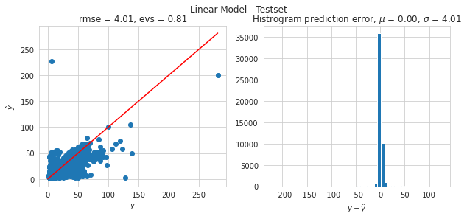
These are (Graph Shown) the RMSE and EVS values which we get after applying above mentioned measurement tools to both the training and test data.
It can be analyze from graph that resulted error values of training and test data are nearly same and it is a good outcome , it means the model is doing what it’s supposed to do.

Slide 10
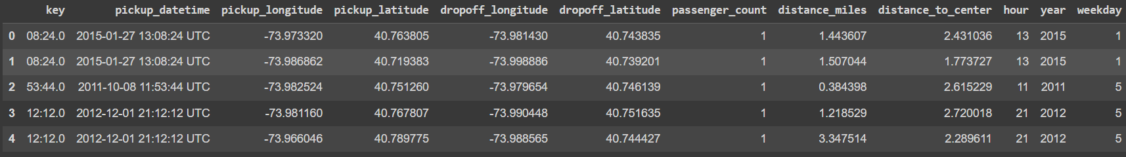
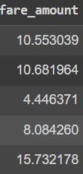
Conclusion
We have successfully built a model using multiple regression that can predict the fare amount of a taxi in various aspects i.e. fare can be predicted for different distances and variable directions , fare is also predicted for day time and night time separately .
Below the resultant model has been provided which shows some predicted amount (Taxi Fare) for the respective keys.

Slide 11

Thank You

